Slide 1
Agenda
Loss landscapes (https://youtu.be/aq3oA6jSGro)
Dual certificates
LP software example
Multiobjective optimization
Highlights so far

Slide 2
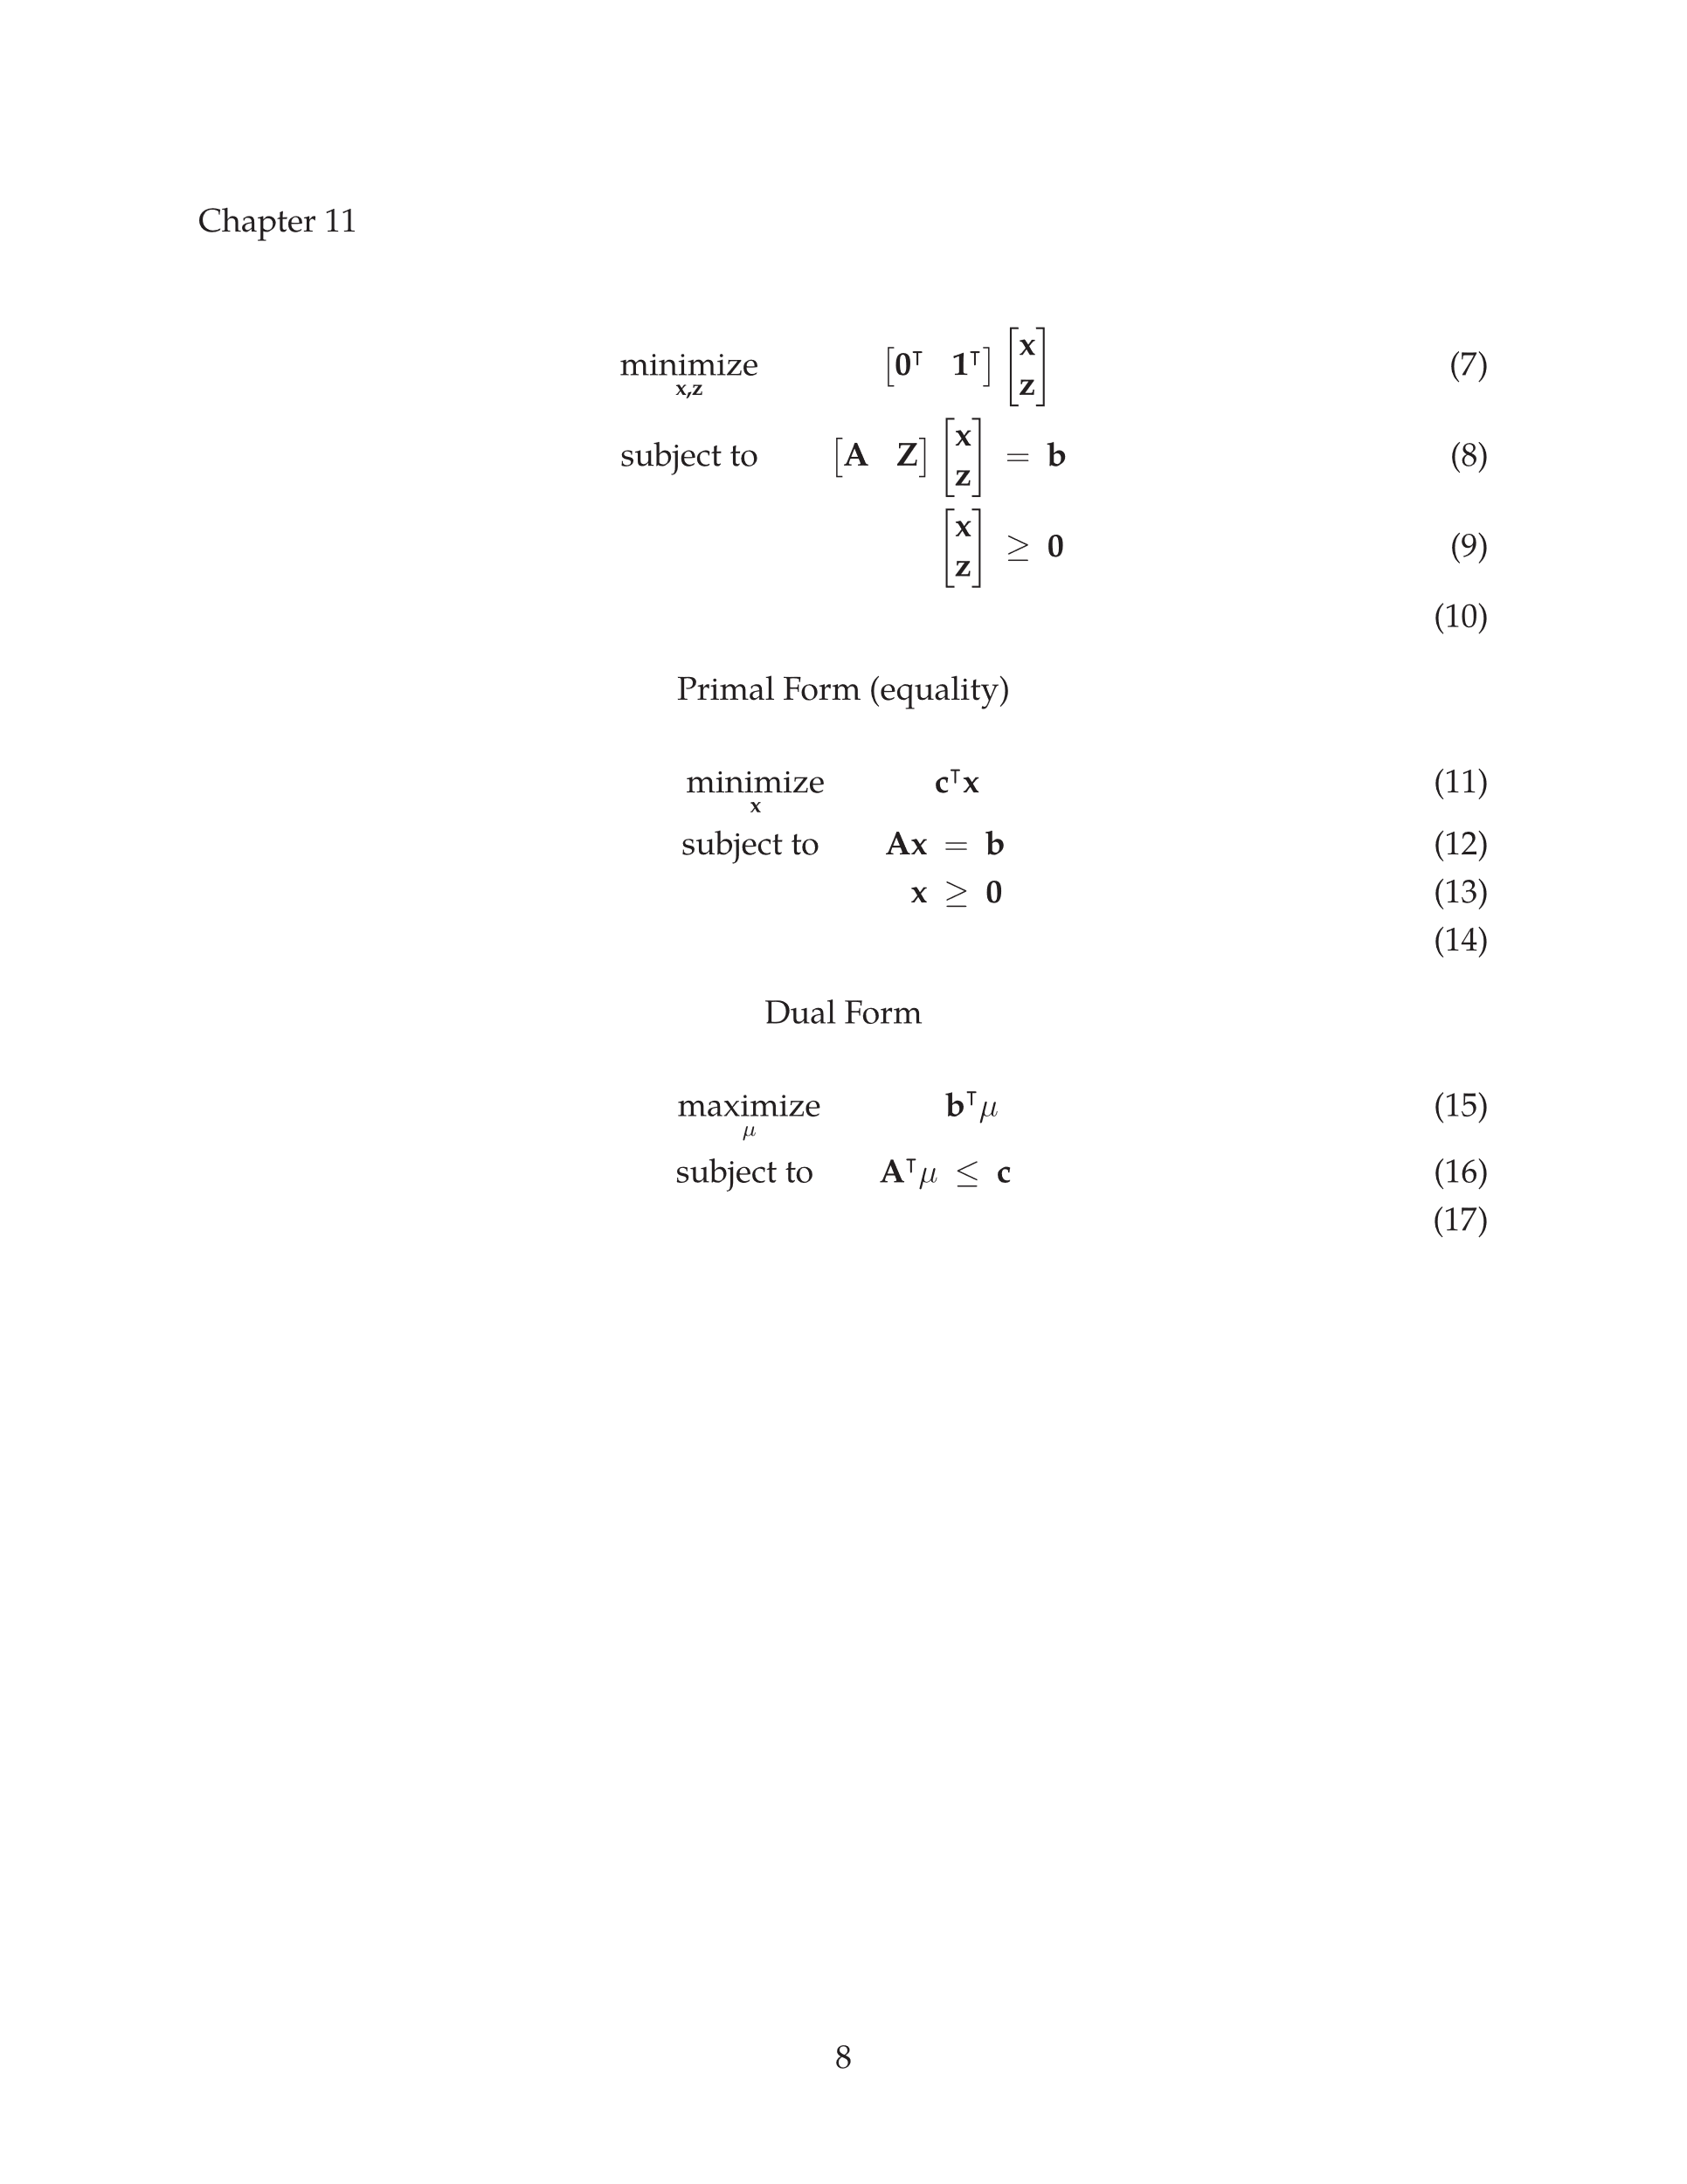
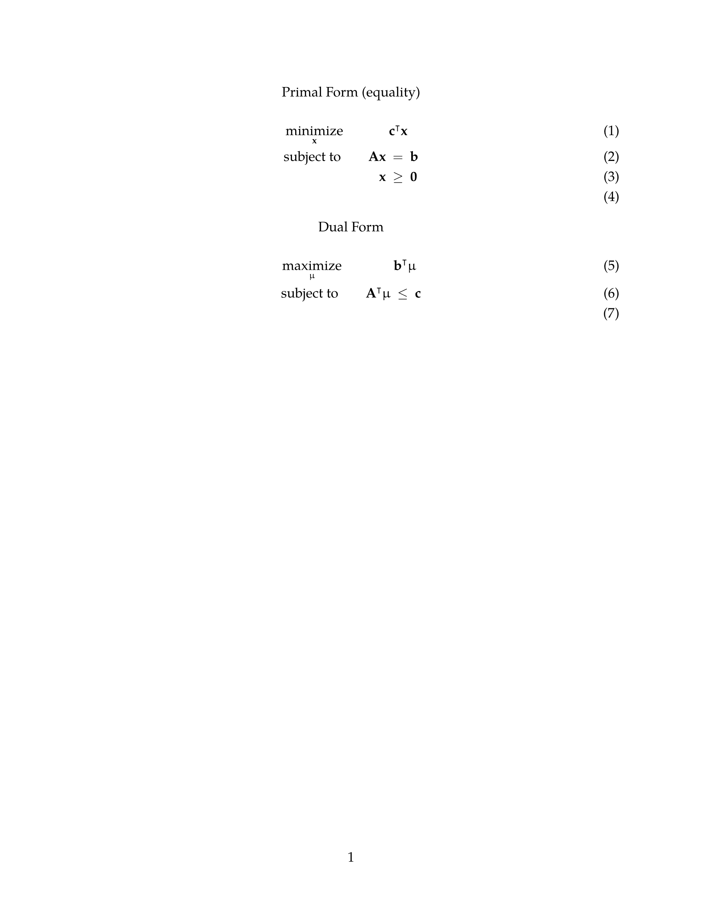
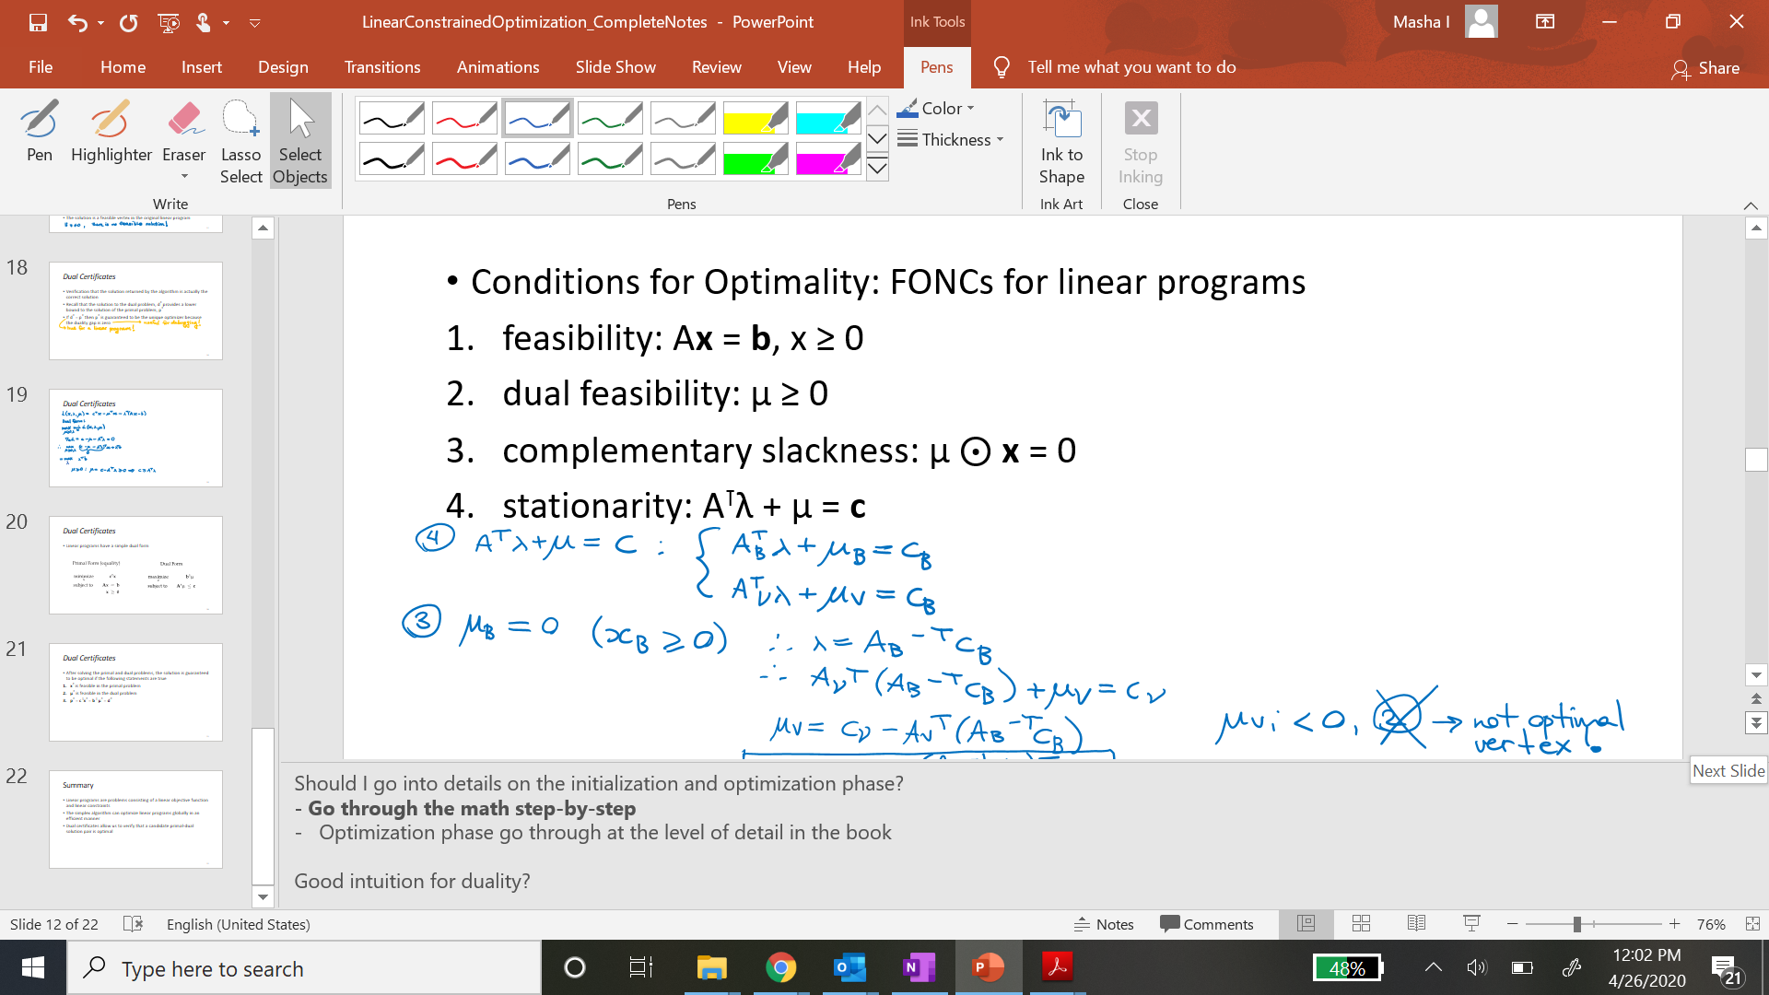
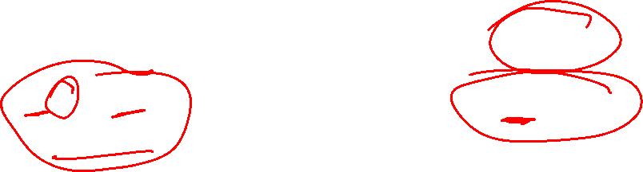
Dual Certificates
Linear programs have a simple dual form

Slide 3
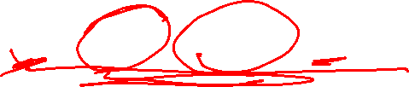
Dual Certificates
After solving the primal and dual problems, the solution is guaranteed to be optimal if the following statements are true
x* is feasible in the primal problem
λ* is feasible in the dual problem
p* = c ⊺x* = b ⊺ λ* = d*

Slide 4
Multiobjective Optimization

Slide 10
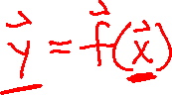
Multiobjective Optimization
Some optimization problems have multiple objectives that required tradeoff decisions

Slide 11
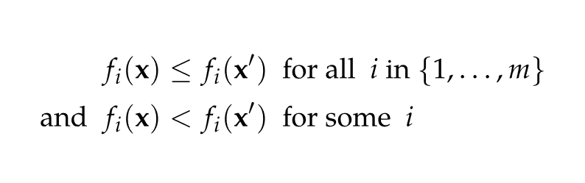
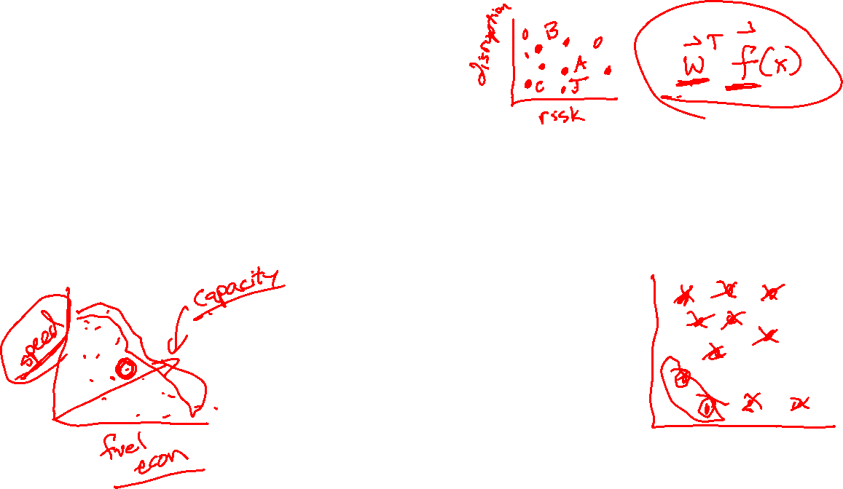
Pareto Optimality
At a Pareto optimal point, increasing one objective value decreases another
In multiobjective optimization, one point dominates another if

Slide 12
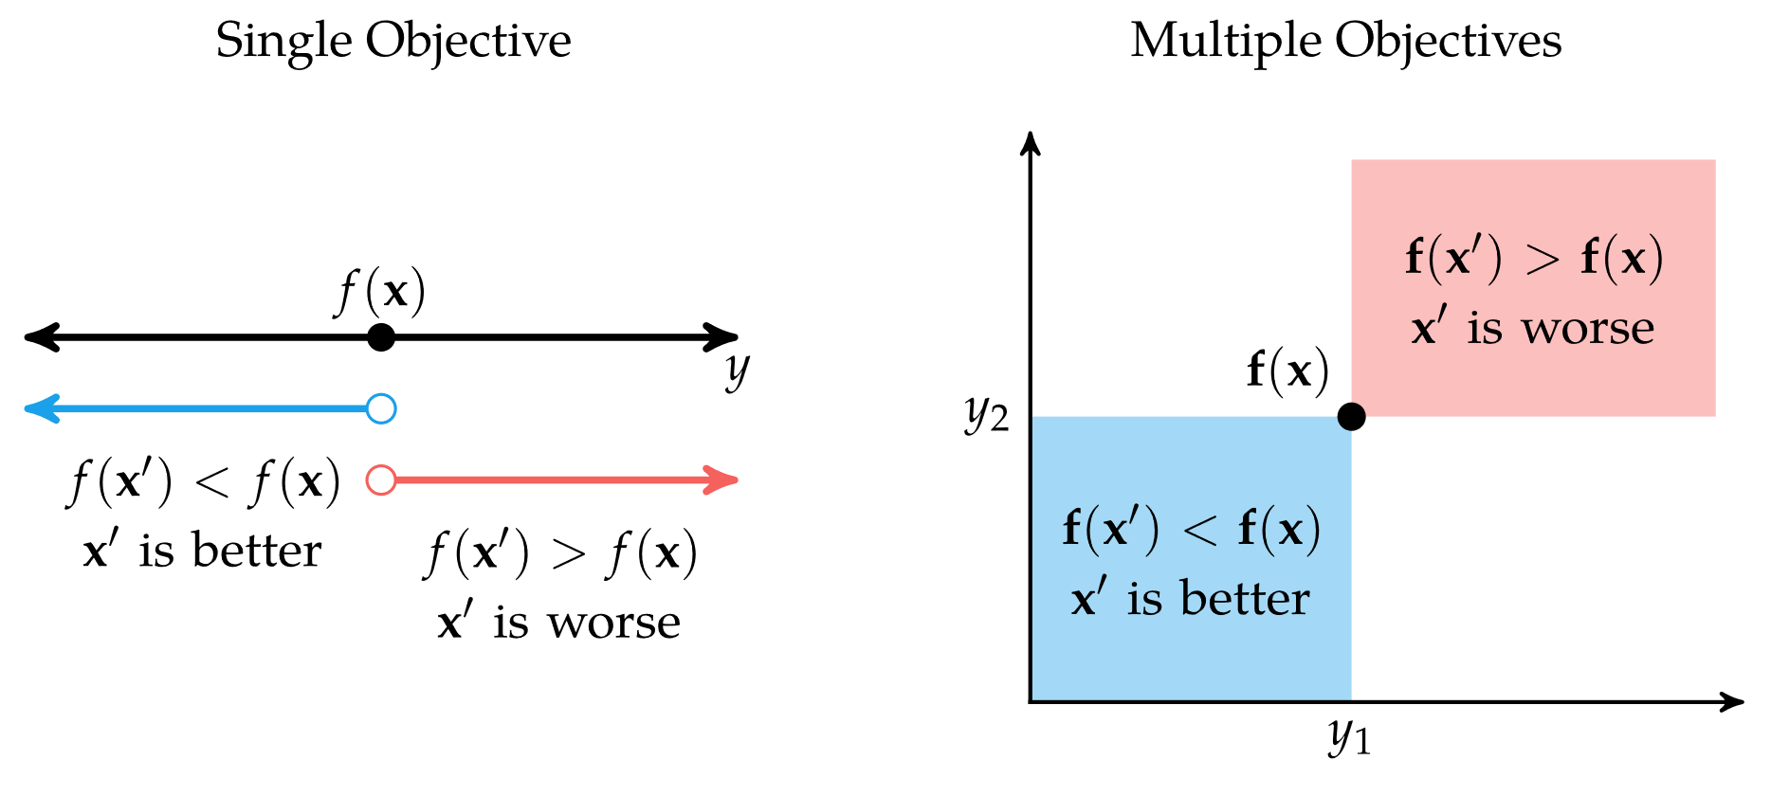
Pareto Optimality

Slide 13
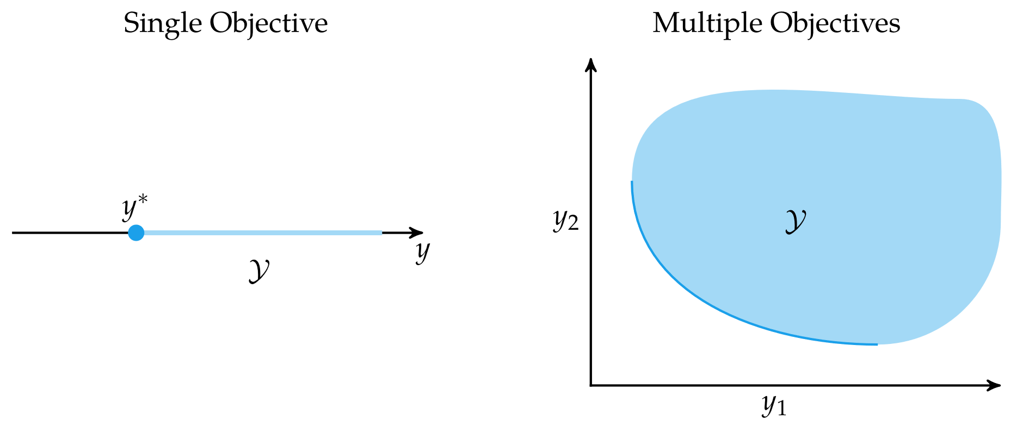
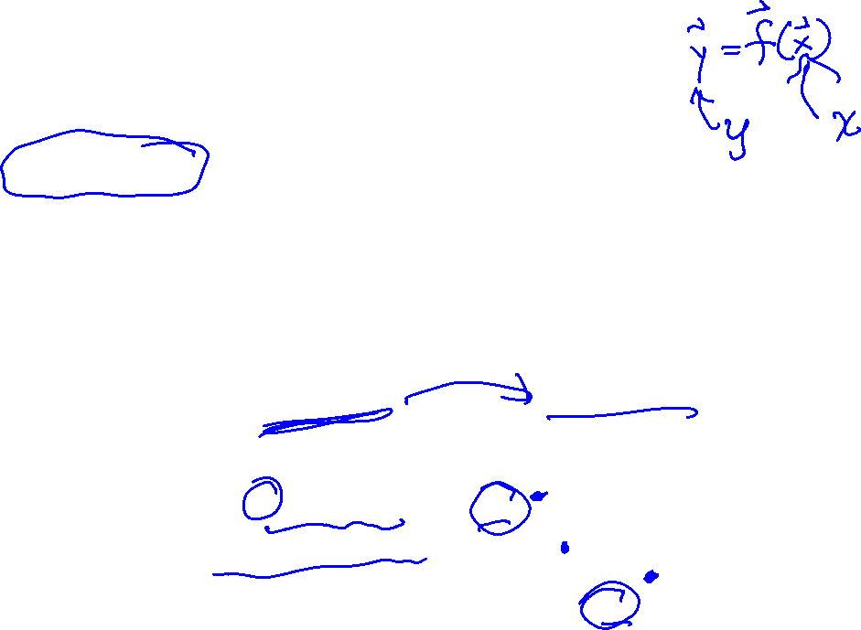
Pareto Optimality: Pareto Frontier
A criterion space is a set of all outputs possible given a space of inputs
In a multidimensional optimization problem, the criterion space is m-dimensional
In m-dimensional space, it is possible for there to be no clearly optimal point

Slide 14
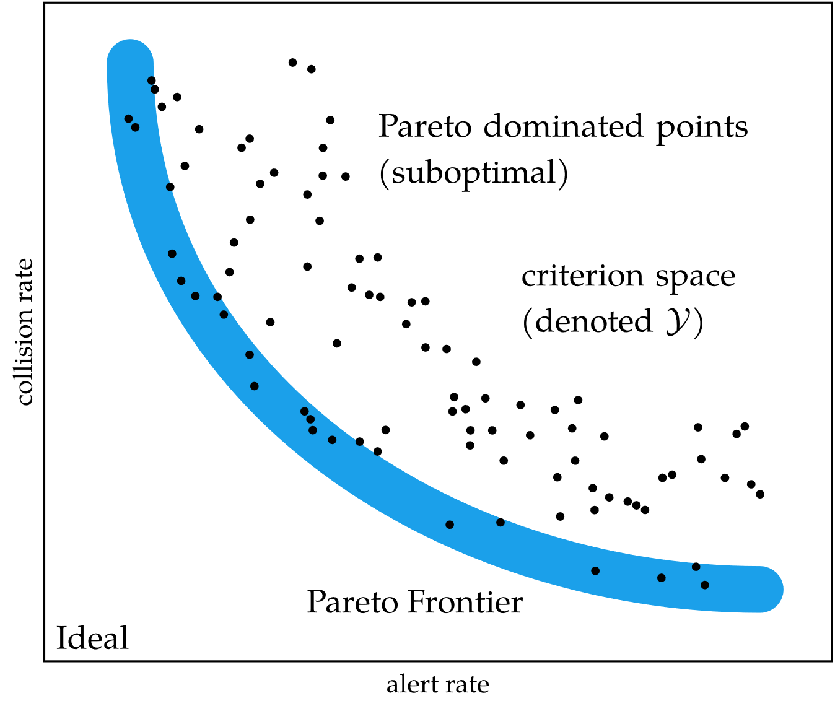
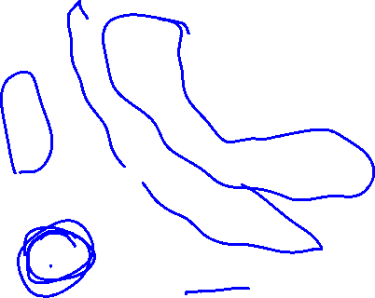
Pareto Optimality: Pareto Frontier
A design point is considered Pareto-optimal if no other point in the criterion space dominates it
The set of all Pareto-optimal points forms the Pareto frontier

Slide 15
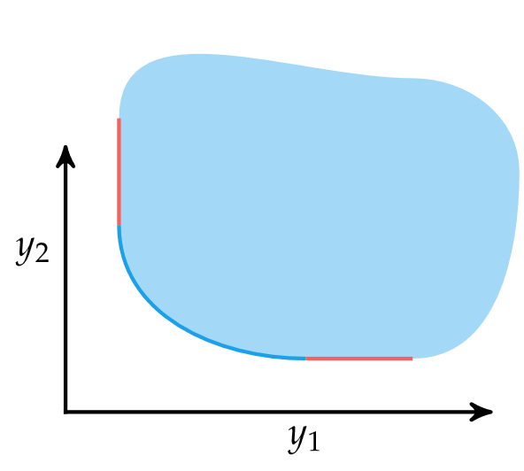
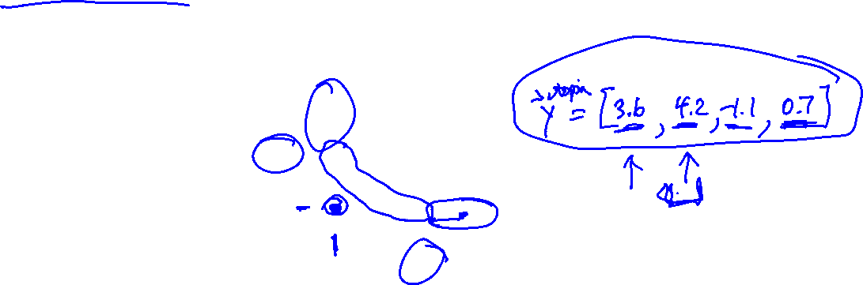
Pareto Optimality: Pareto Frontier
The utopia point is the component-wise optimal point. It may not be in the actual criterion space
Weakly Pareto-optimal points are those on the Pareto frontier that cannot be improved simultaneously in all objectives

Slide 16
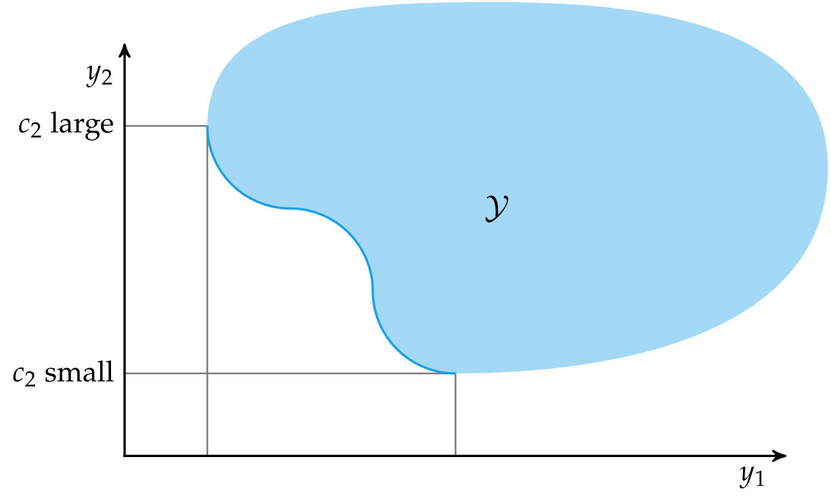
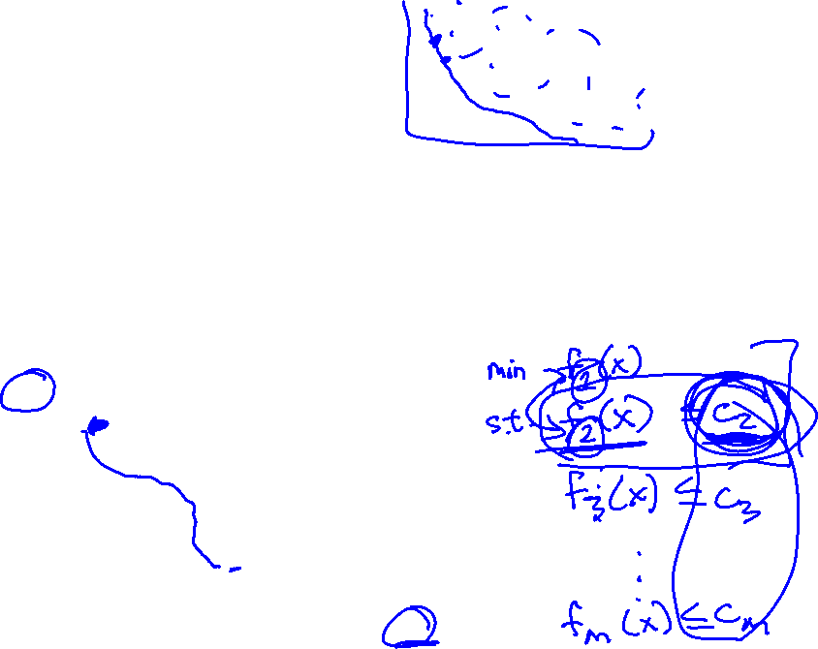
Constraint Methods
There are various methods for generating the Pareto frontier
The constraint method constrains all but one of the objectives to produce a unique optimal point in the criterion space
The constraints are then modified to trace out the Pareto frontier

Slide 17
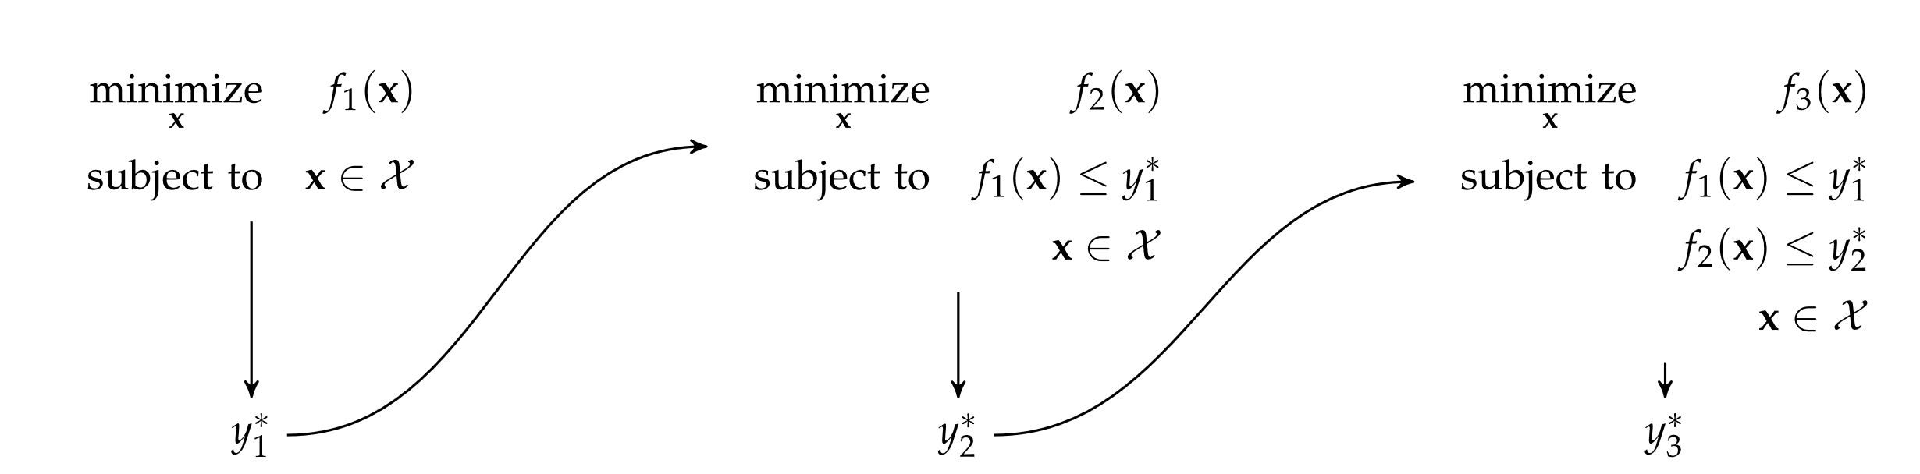
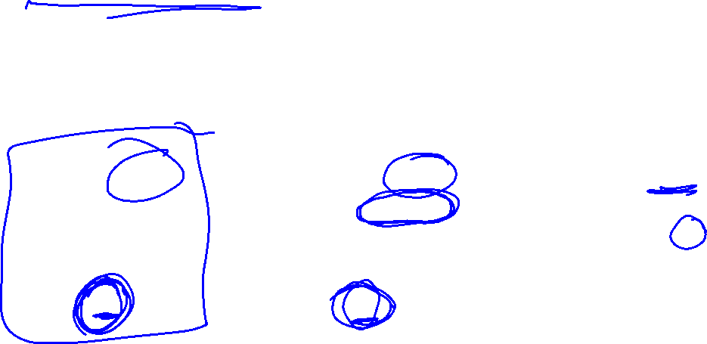
Constraint Methods
The lexicographic method ranks the objectives in order of importance and performs a series of single-objective optimizations in order of importance
Each optimization problem includes constraints to preserve the optimality of the previously optimized objectives

Slide 18

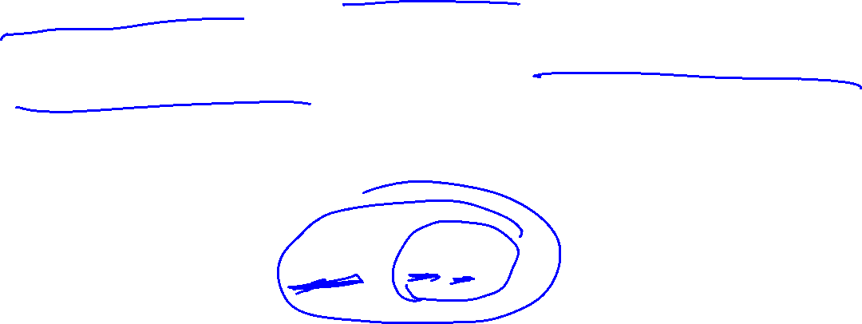
Weight Methods
A designer can encode preferences over the objectives as a vector of weights
The pareto frontier can be generated by sweeping over the space of possible weights
The weighted sum method combines multiple objective functions into one using a constant vector inner product

Slide 19
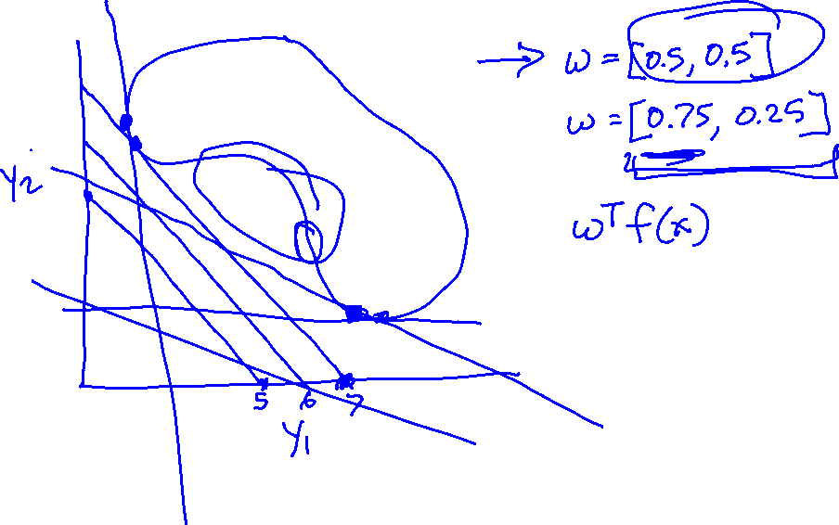

Slide 20
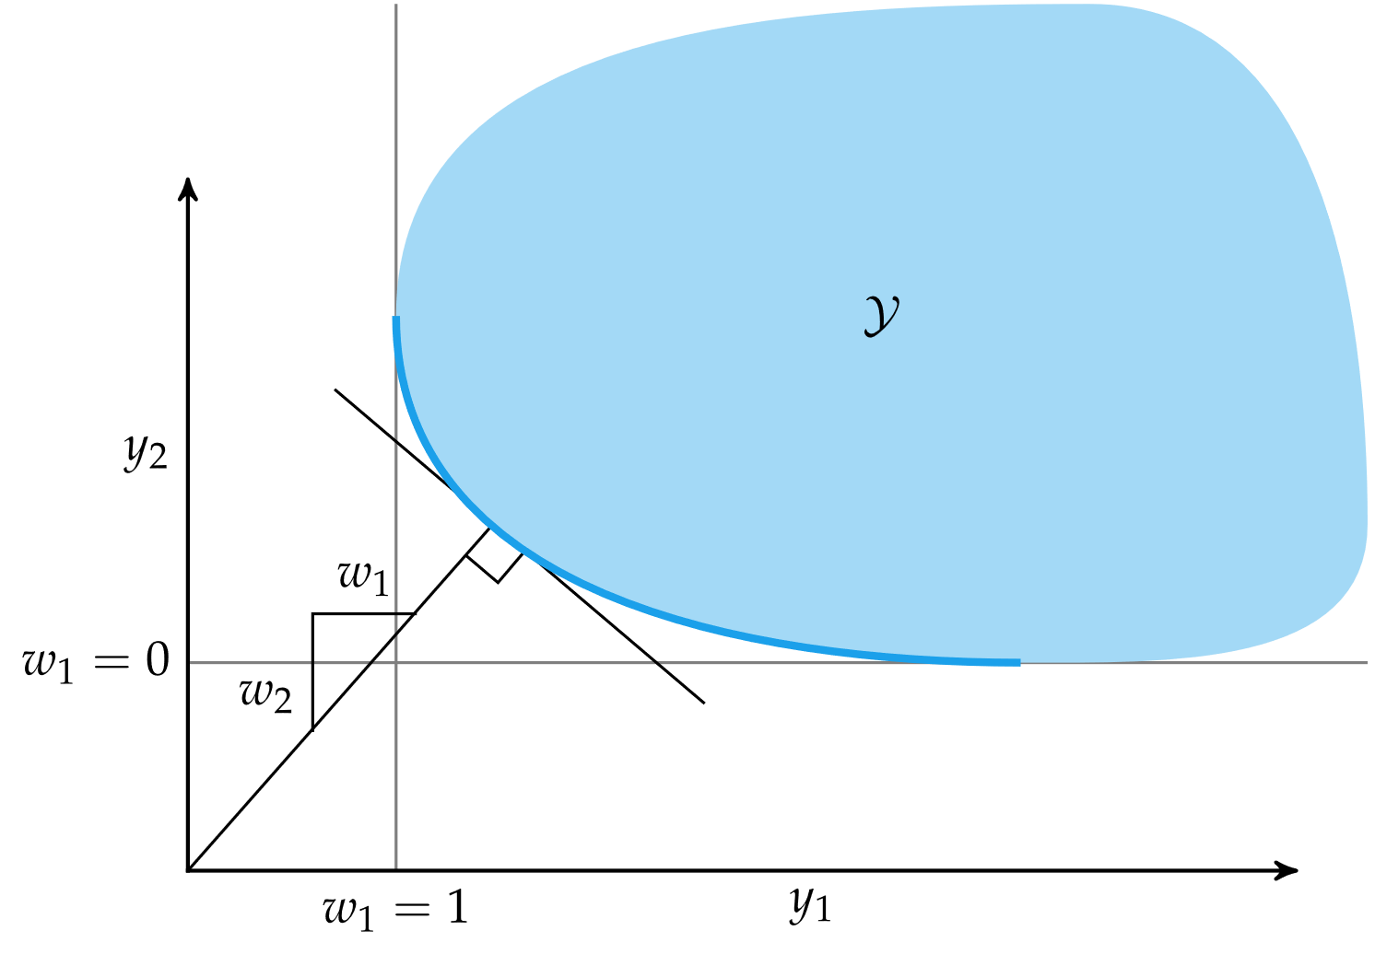
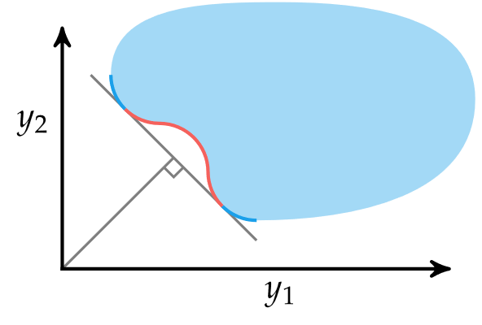
Weight Methods
Note: weighted sum methods cannot obtain points in red

Slide 21
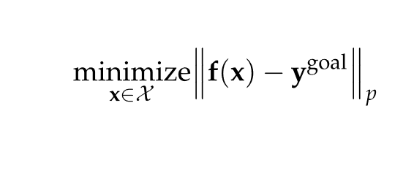
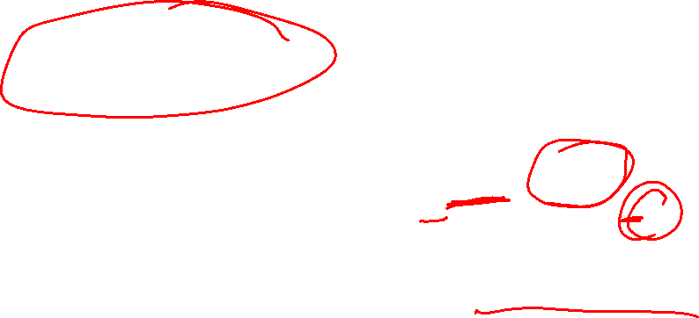
Weight Methods
Goal programming converts multiple objectives into a single objective using a norm between f(x) and a goal point
Typically, the goal point is the utopia point

Slide 22
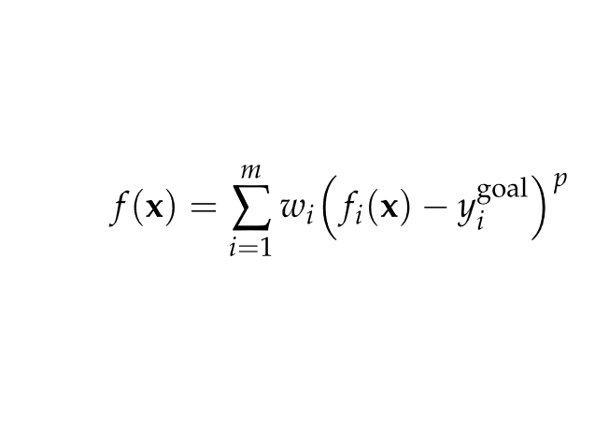

Weight Methods
Weighted exponential sum combines goal programming and the weighted sum method
Here, w is a vector of weights that sum to 1 and p ≥ 1

Slide 23
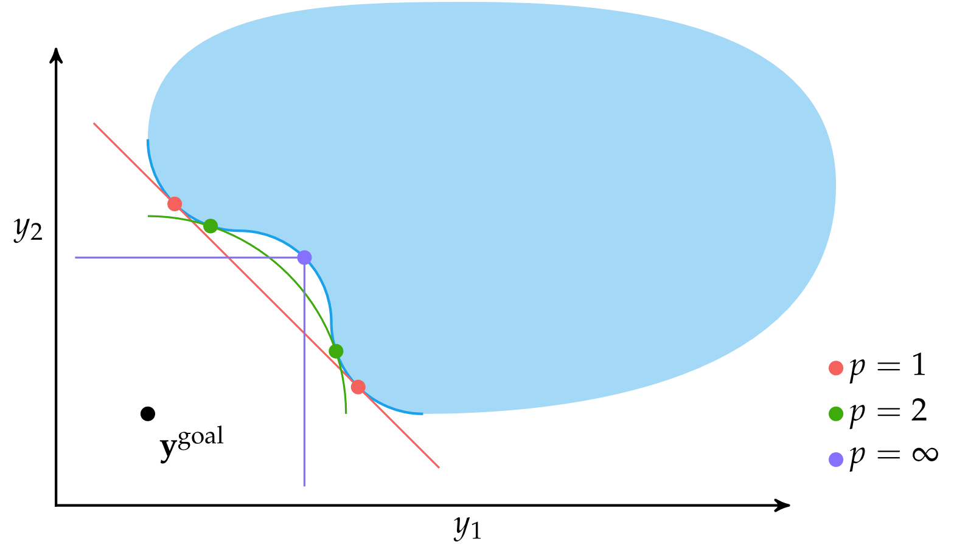
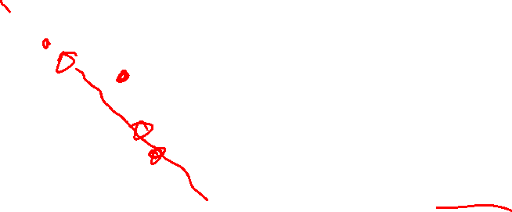
Weight Methods
Weighted exponential sum for different values of p

Slide 24
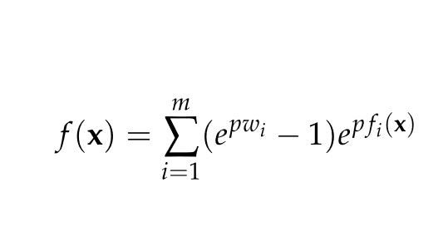
Weight Methods
Previous methods cannot obtain points in nonconvex portions of the Pareto frontier
The exponential weighted criterion can provide Pareto-optimal points in nonconvex regions
Note: High values of p can lead to numerical overflow

Slide 25
Multiobjective Population Methods
A population is partitioned into several subpopulations
Each subpopulation is optimized with respect to a different objective

Slide 26
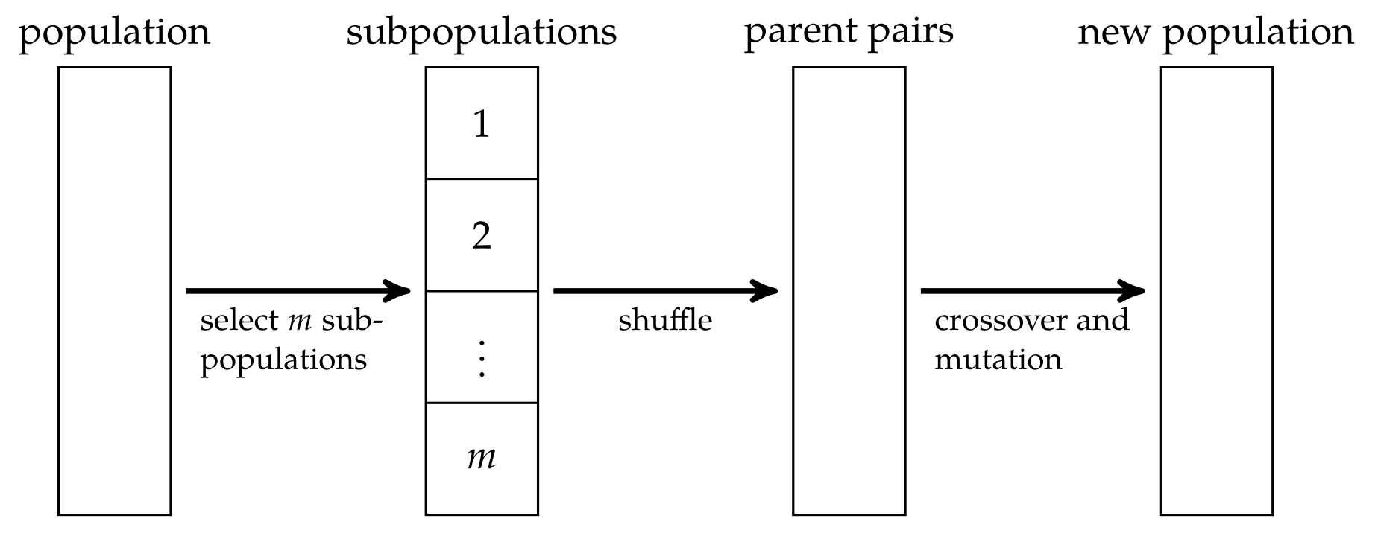
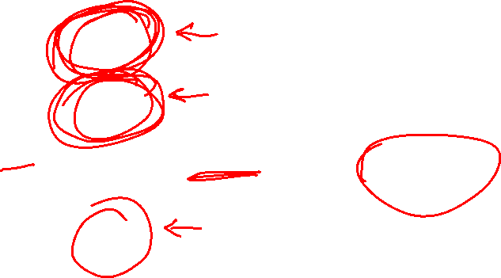
Multiobjective Population Methods
The vector evaluated genetic algorithm randomly partitions subpopulations at each generation

Slide 27
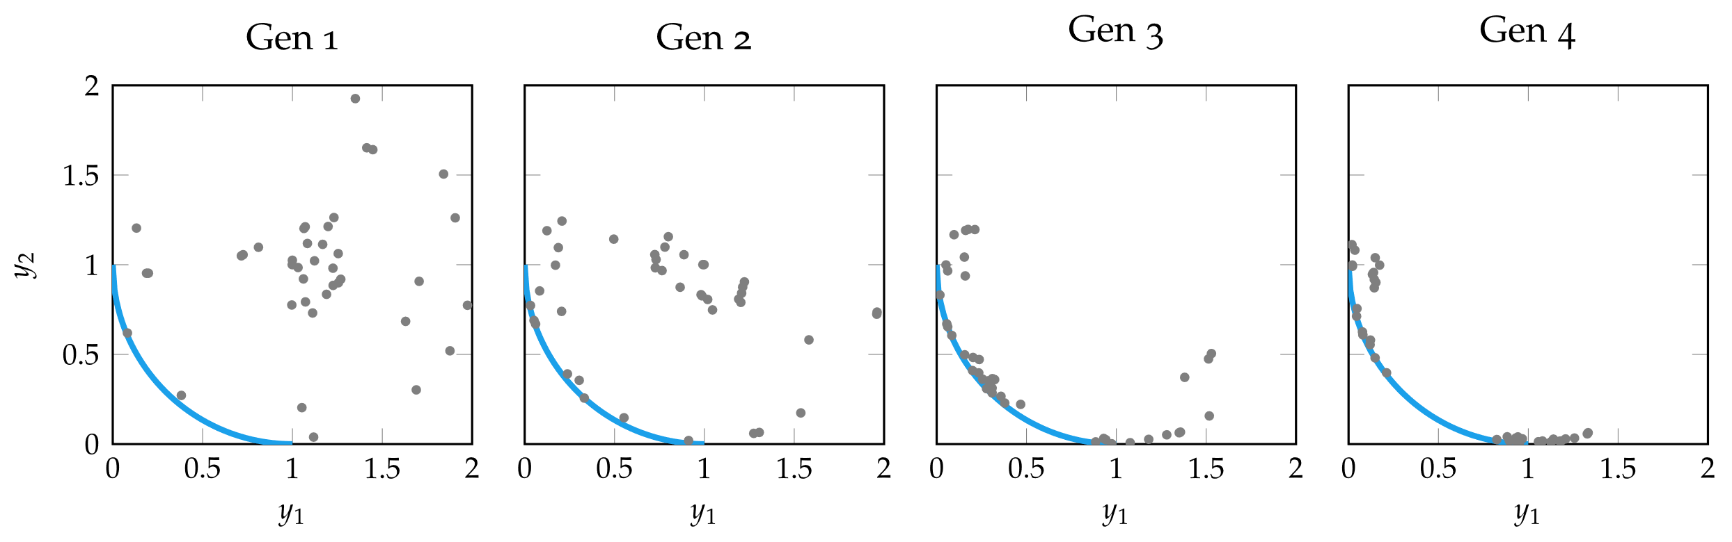

Multiobjective Population Methods

Slide 28

Multiobjective Population Methods
Nondomination ranking is used to rank individuals in the population
Nondominated individuals (Pareto-frontier)
Nondominated by any except those in (1)
Nondominated by and except those in (1) or (2)
…

Slide 29
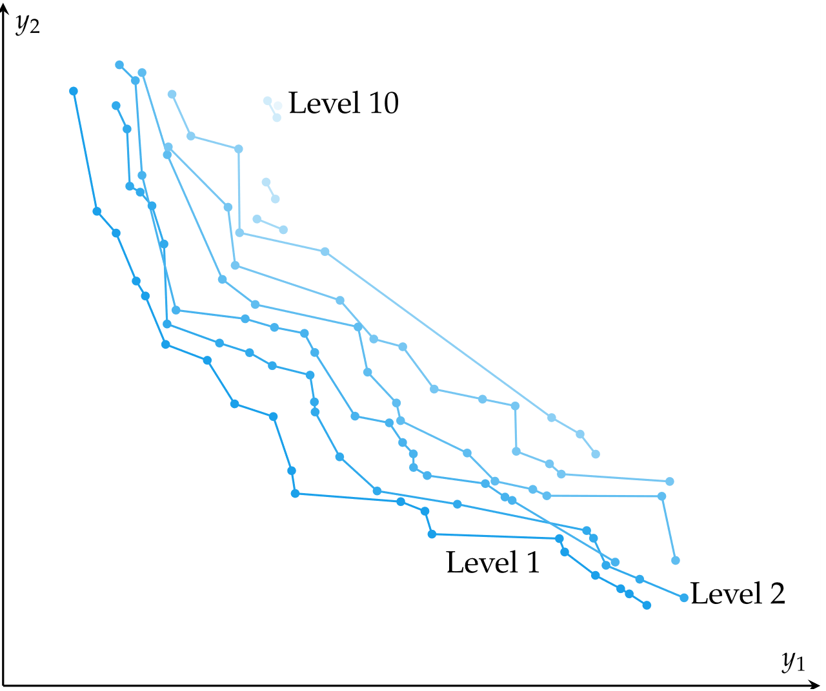
Multiobjective Population Methods

Slide 30
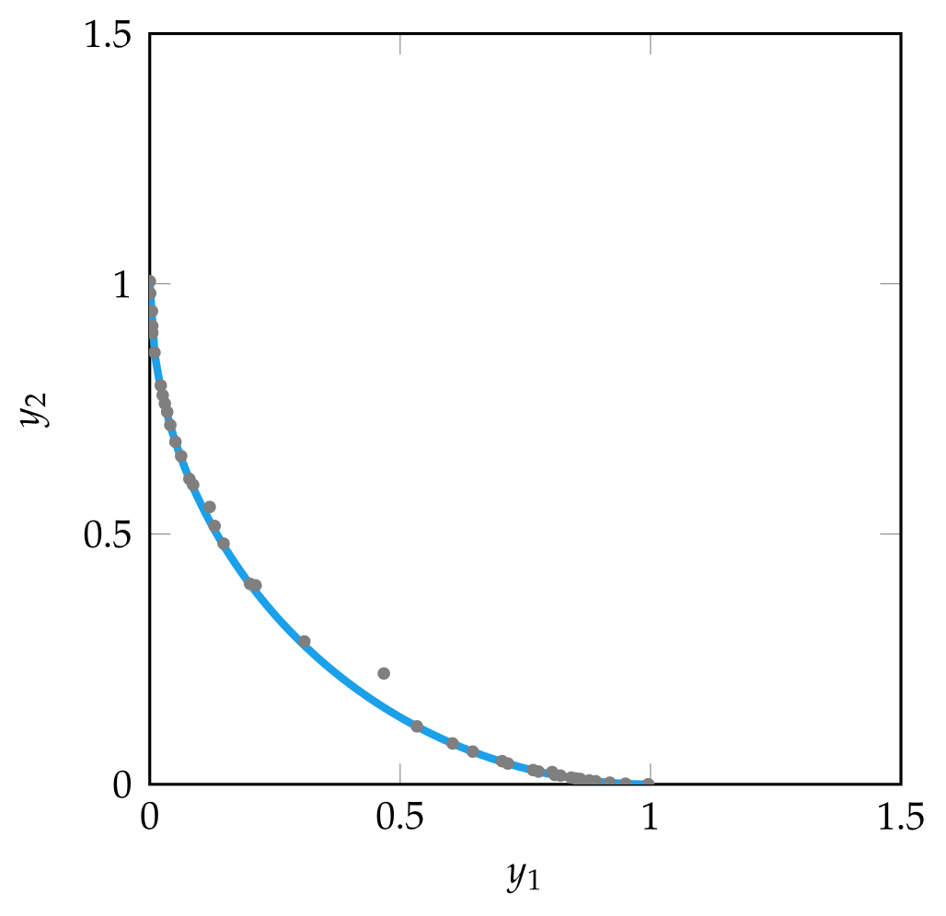

Multiobjective Population Methods
In multiobjective population methods, a population that approximates the Pareto frontier is called a Pareto filter
At every generation, dominant individuals are retained and dominated individuals are removed

Slide 31
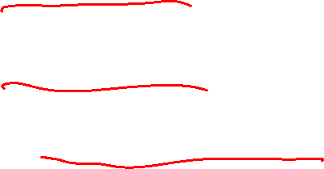
Multiobjective Population Methods
A niche is a focused cluster of points, typically in the criterion space
Niche techniques help encourage an even spread of points across the Pareto frontier
In fitness sharing, the individual objective values are penalized if neighboring points are too close
In equivalence class sharing, when two individuals are compared, their nondomination ranking is considered first, then fitness sharing is used to as a tie-breaker

Slide 32


Multiobjective Population Methods
Improved coverage of Pareto frontier using fitness sharing

Slide 33
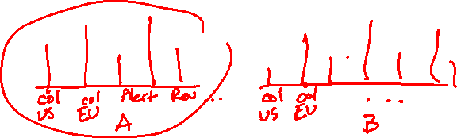
Preference Elicitation
If using a weighted sum method, how should the weights be determined?
Preference elicitation involves inferring a scalar-valued objective function from the preferences of experts about objective tradeoffs
A common approach is asking experts to choose preference between the optimized results of two weight distributions w_{a} and w_{b}. These distributions are continually adjusted until w aligns with user preferences

Slide 34
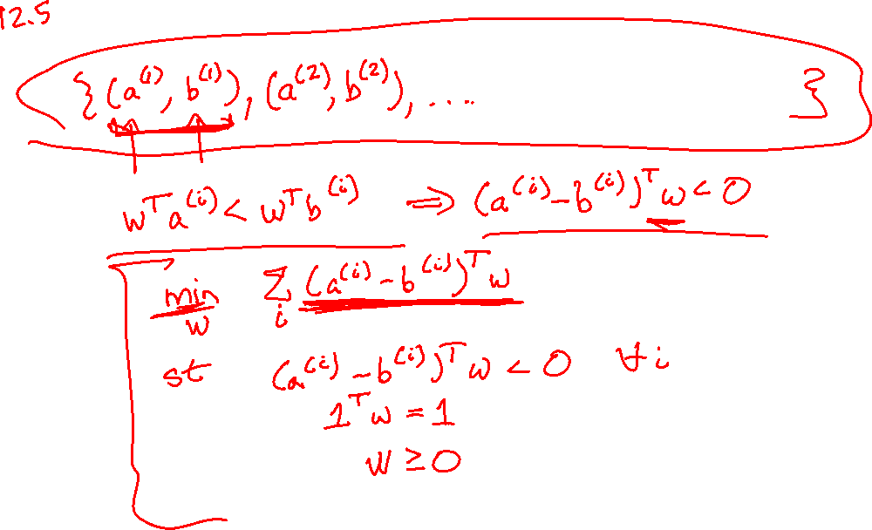

Slide 35
Preference Elicitation
The process of choosing w_{a} and w_{b} such that at each iteration, the expert response is the most informative
If the weight vector is length n, then the space of possible weights forms a subspace in n-dimensional space W, from which both w_{a} and w_{b} must be chosen
Q-Eval: a greedy heuristic strategy that bisects W and chooses w_{a} and w_{b} from either side
Polyhedral method: reduces uncertainty and balances breadth by approximating W with a bounding ellipsoid

Slide 36
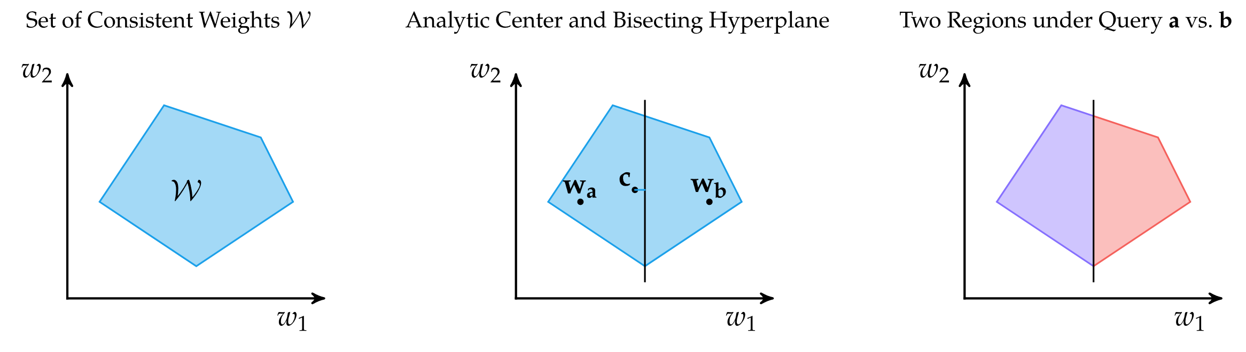
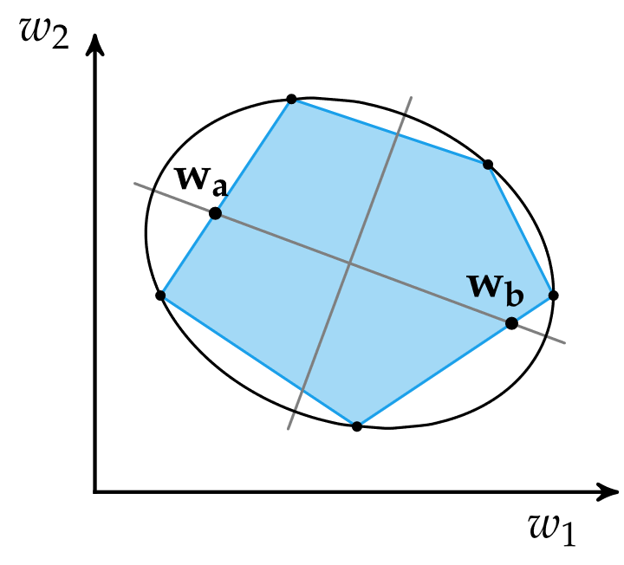
12.5 Preference Elicitation
Q-Eval
Polyhedral

Slide 37
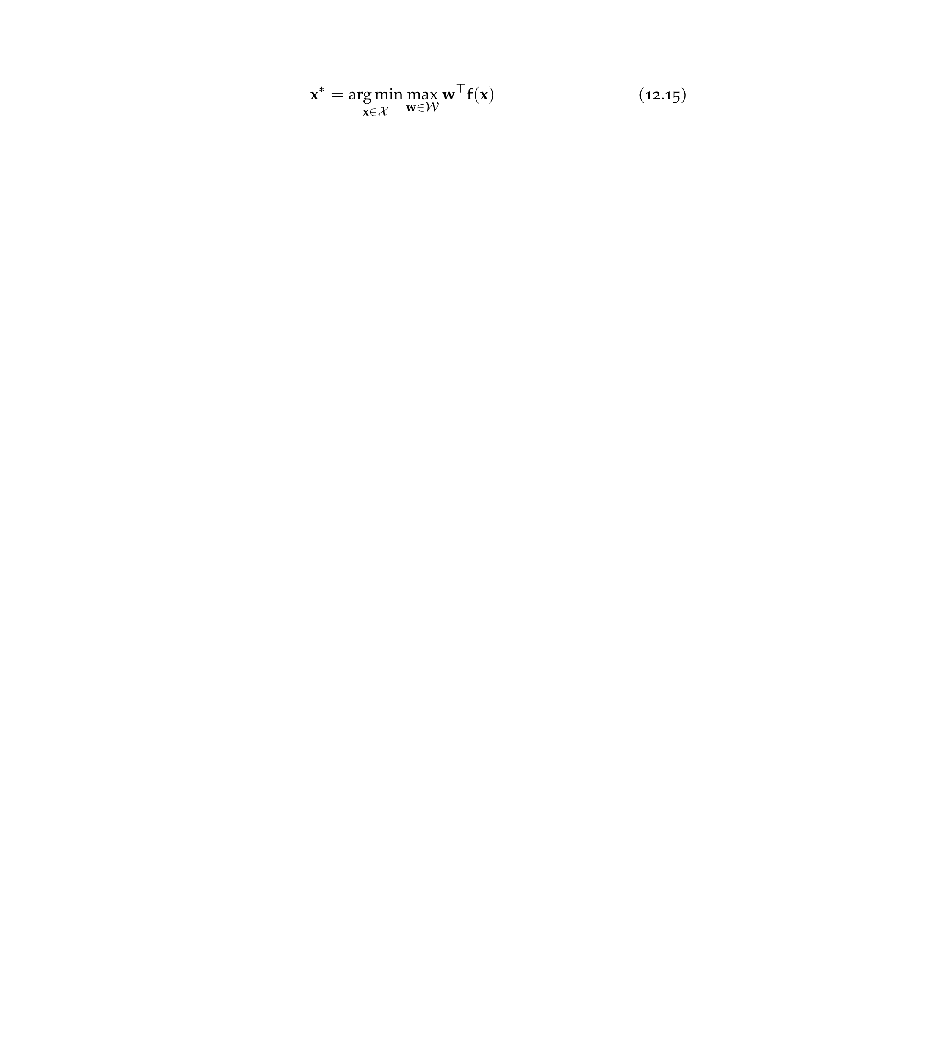
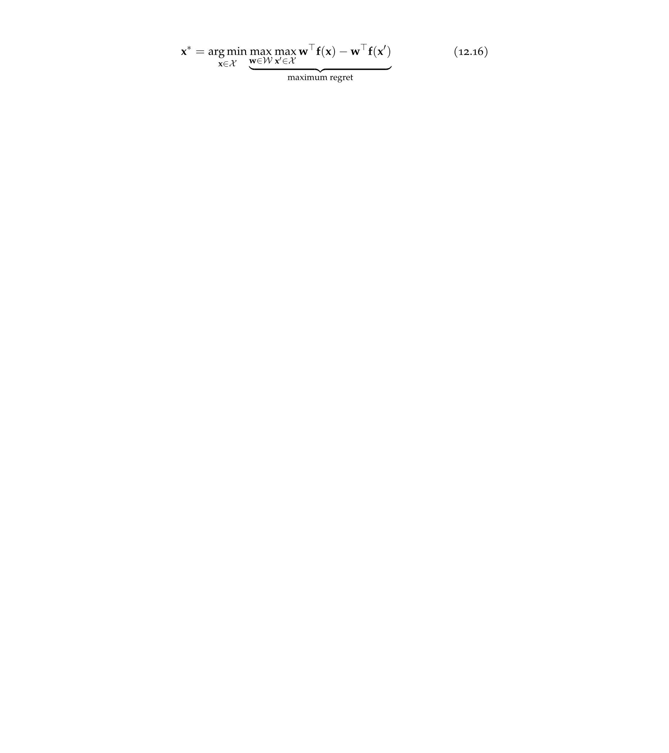
Preference Elicitation
Although query methods reduce the search space efficiently, the last step of selecting a final design is called design selection
Decision quality improvement method is a minimax method that minimizes the worst-case objective value cost
Minimax regret minimizes the maximum possible regret

Slide 38
Highlights

Slide 39
Summary
Design problems with multiple objectives often involve trading performance between different objectives
The Pareto frontier represents the set of potentially optimal solutions
Vector-valued objective functions can be converted to scalar-valued objective functions using constraint-based or weight-based methods

Slide 40
Summary
Population methods can be extended to produce individuals that span the Pareto frontier
Knowing the preferences of experts between pairs of points in the criterion space can help guide the inference of a scalar-valued objective function

